Slide 1
SPARSITY
Darius Zamani & Zikun Cao
Vivli and Microsoft Innovation Challenge 2019
District Hall, Boston MA
REAL-TIME CLINICAL TRIAL DATA SHARING WITH TRANSPARENCY

Slide 2
The wait….
Those suffering from rare diseases have a time-dependent need for treatment
Data-sharing Time: Length of Trial + Peer Review process for output
Other trials using the same experimental for other purposes

Slide 3
Block Chain
Transparency
Data encryption with keys
Utility: Contracts (e.g. Ethereum) and Quorum Voting (e.g. Algorand)
Real-time tracking of data with consensus

Slide 4
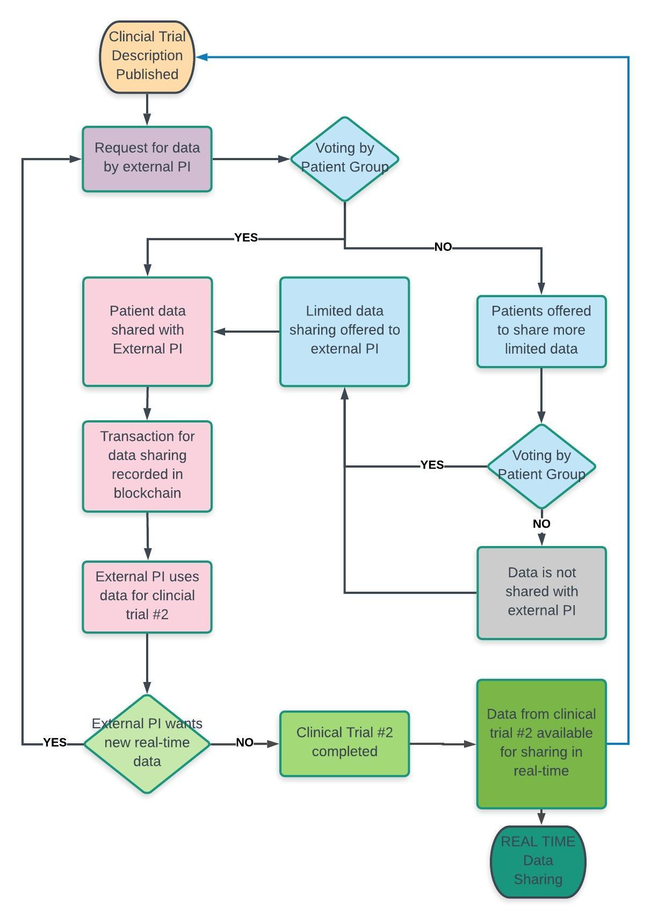
SPARSITY
FLOW CHART
REAL TIME
TRIAL DATA
SHARING

Slide 5
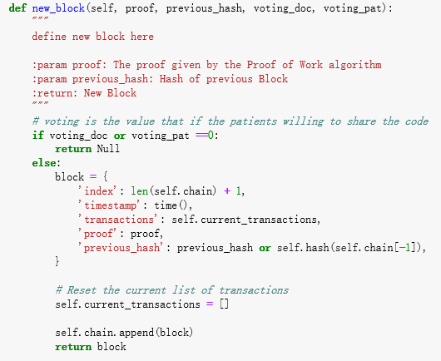
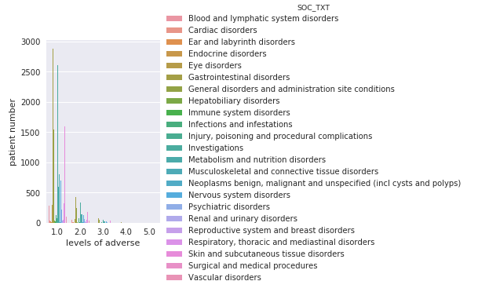
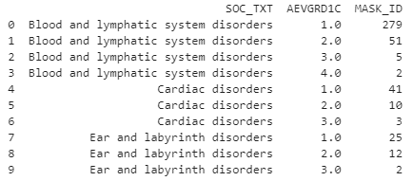
Sparsity Platform

Slide 6
Considerations
Who owns the research? Publications…
Pharmaceutical companies role
FDA: Accelerated Approvals…Right to Try…Orphan Drug Designations…Medical Devices…

Slide 7
Future Directions
Easier and faster data sharing with FDA
Incorporate data with HIPPA Compliant EMR (e.g. Epic)
Novel investigational collaborations
Patient autonomy in digital era
Post-market surveillance

Slide 8

Thank you
Patient
Consensus
New Drug
Discoveries

